Slide 1
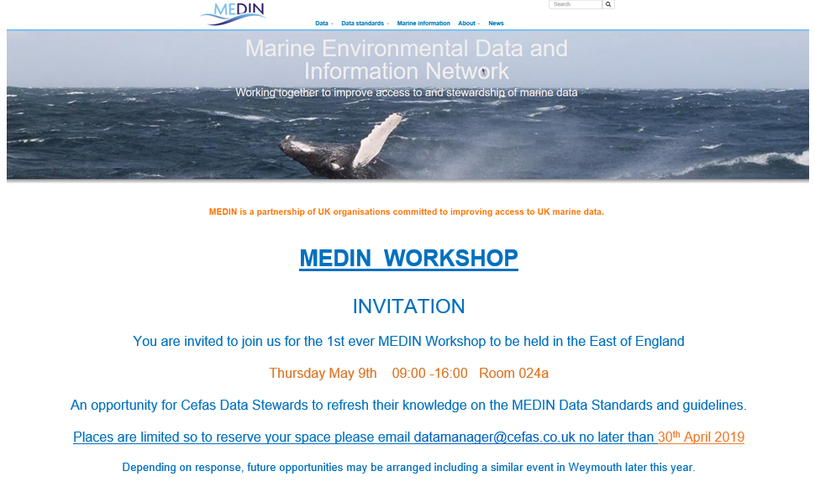
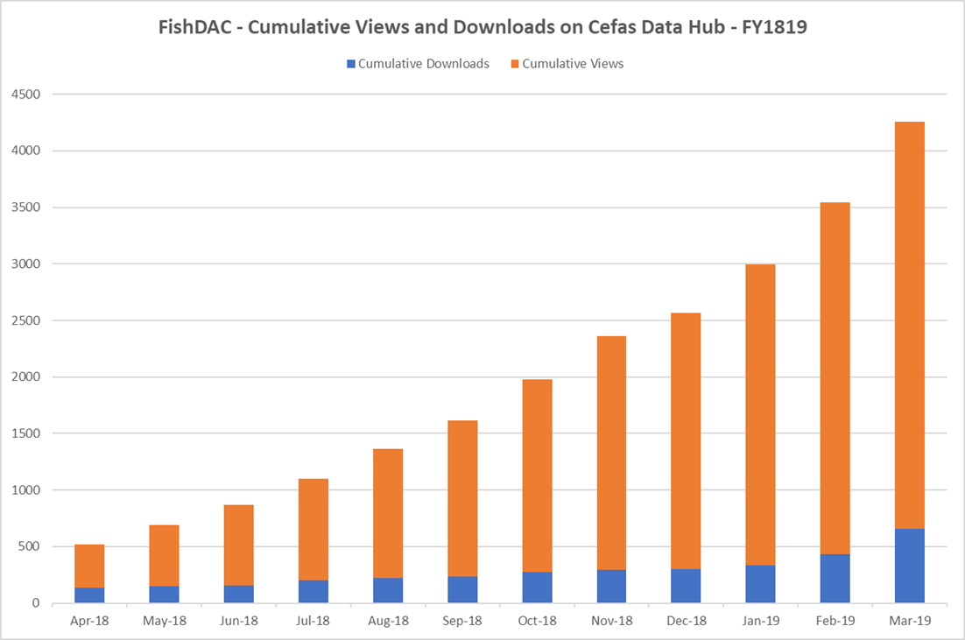
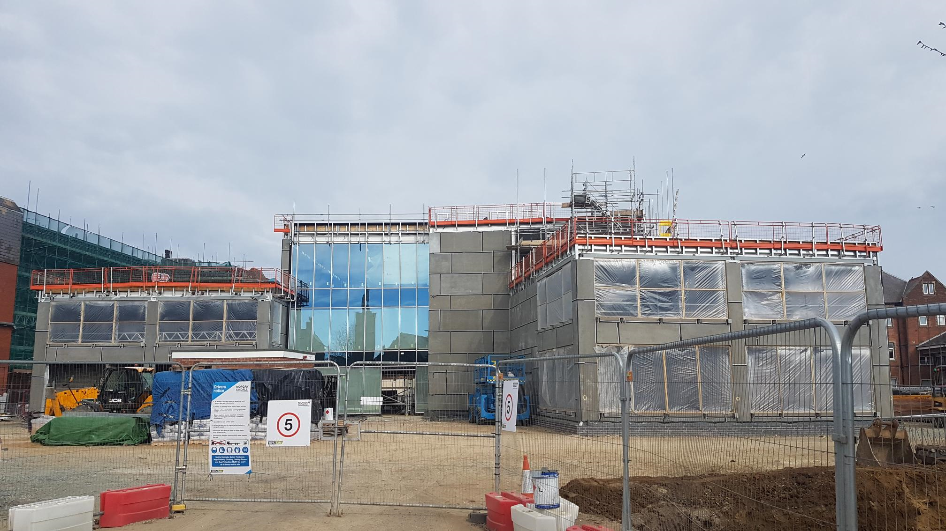
FishDAC Update – Cefas – April 2019
Estates
Cefas Data Hub
Training
Migration to New Building Oct-19
> 4000 views and downloads in FY1819 (out of 10000 total for CDH)
MEDIN bespoke workshop – 9th of May
Physical Data Archiving Remains the Focus
New YFS Survey 30 yr. timeseries Dataset Released – Linked Data & EventCore planned
Internal DM Training Course In Progress for Project Managers – Data Steward and Principal Investigators training planned

Slide 2
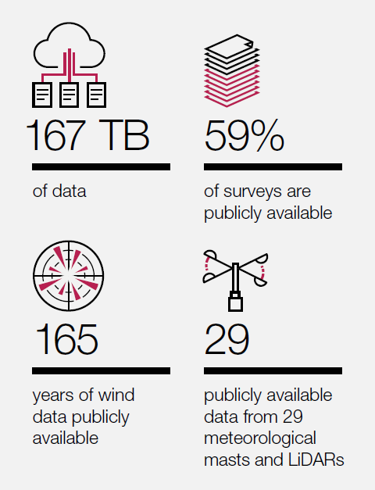
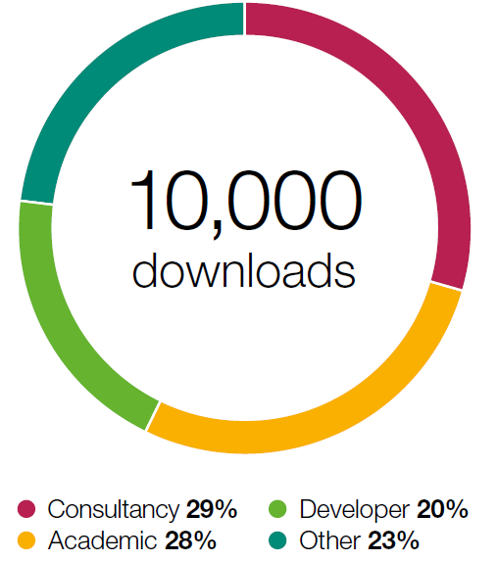
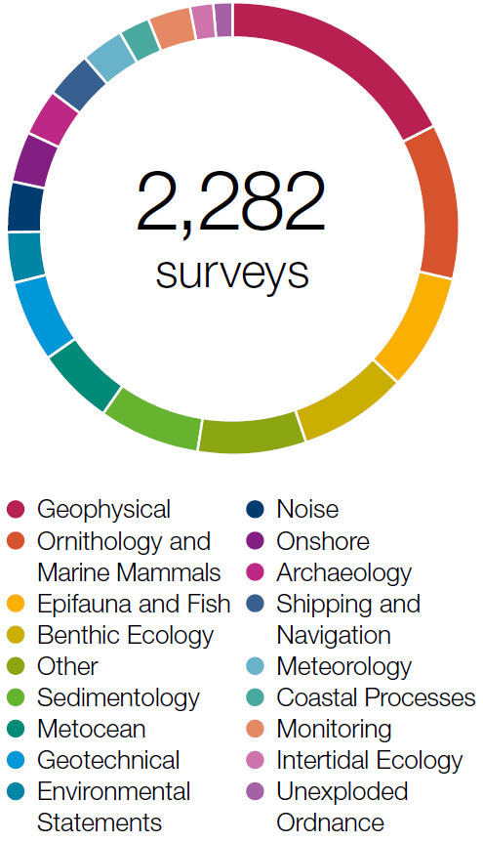
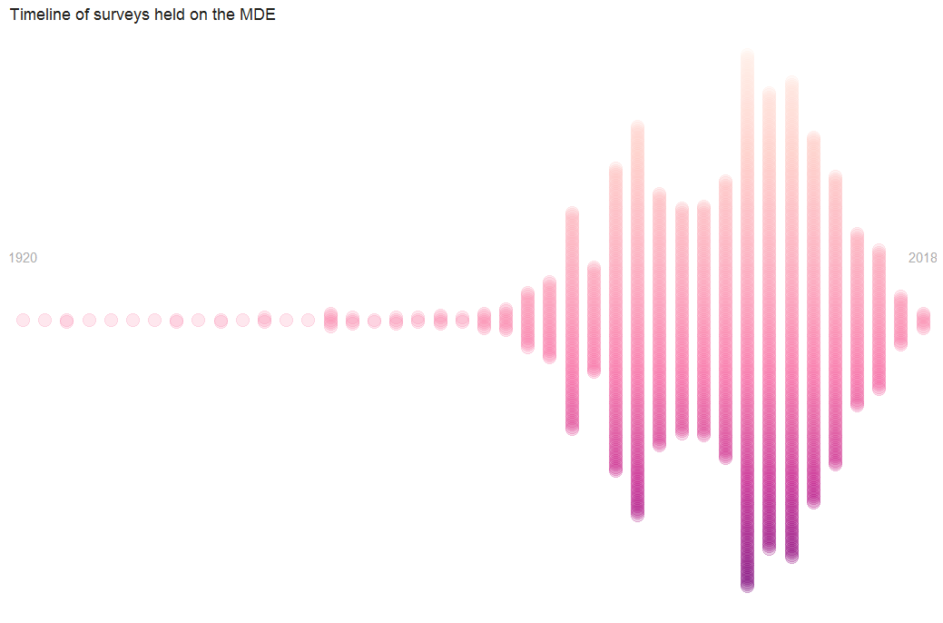
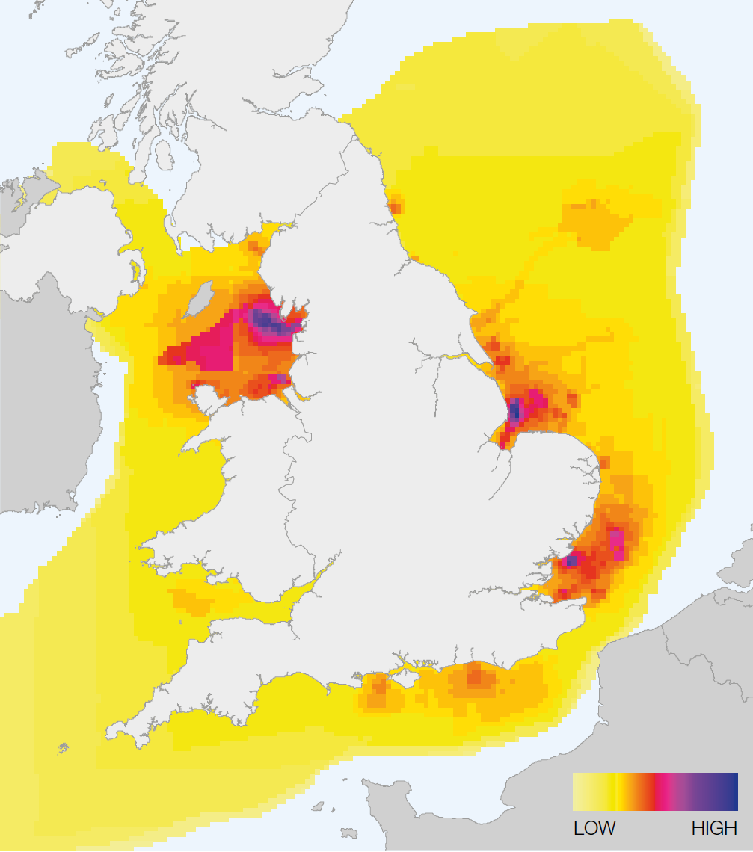
Marine Data Exchange
2018-19
126 new surveys
46 (37%) of the surveys do not yet meet MEDIN Data Guideline and/or TCE Data Standards
1,448 publicly available, discoverable and downloadable
258 published in 2018/19
7, 300 visits to www.marinedataexchange.co.uk
14% of visitors downloaded data
Hackathon
MDE Public Website
Evidence Based Decision Making

Slide 3
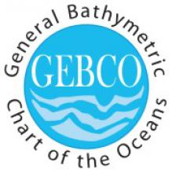
BODC Highlights
GEBCO 2019 Grid Release – Global terrain at 15 arc-second intervals.
EMODnet
New tenders have gone out
>7000 new records sent to SeaDataCloud
Working closely with SeaDataCloud on their checking software and standards with BODC data/metadata to be used as some optimum examples.
Vocabs
IMDIS presentations
Workshop with BCO-DMO in Dublin
New RDA working group created “Interoperability of Observable Property Descriptions WG”

Slide 4
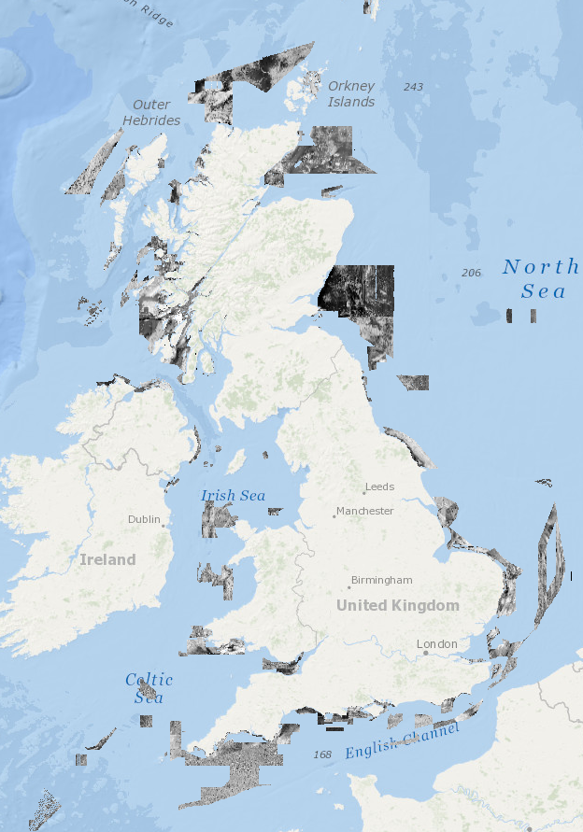
BGS - Geology and Geophysics DAC
Ongoing archiving Marine Conservation Zone (MCZ) data - total so far: 89 site/survey datasets from 57 sites/2396 grab samples
Ongoing archiving CHP HI survey backscatter & sample data
Offshore GeoIndex:
  Version of 2 of the Backscatter layers released (145 CHP, 21 BGS, 35 MCZ)
  New WMS for Factor Maps released
MEDIN Grab and Core data guideline - PSA/geological data
Webpages updated
EMODnet – Ingestion, Geology, Bathymetry
Geospatial Commission – 3rd party data, Data Discoverability, Licensing, etc
NGR Core sample analysis extraction project for IGI/OGA
BGS White Ribbon Firth of Forth survey to test new multibeam kit/collect seismic data
Ongoing collation of Site Survey metadata
Offshore GeoIndex backscatter

Slide 5
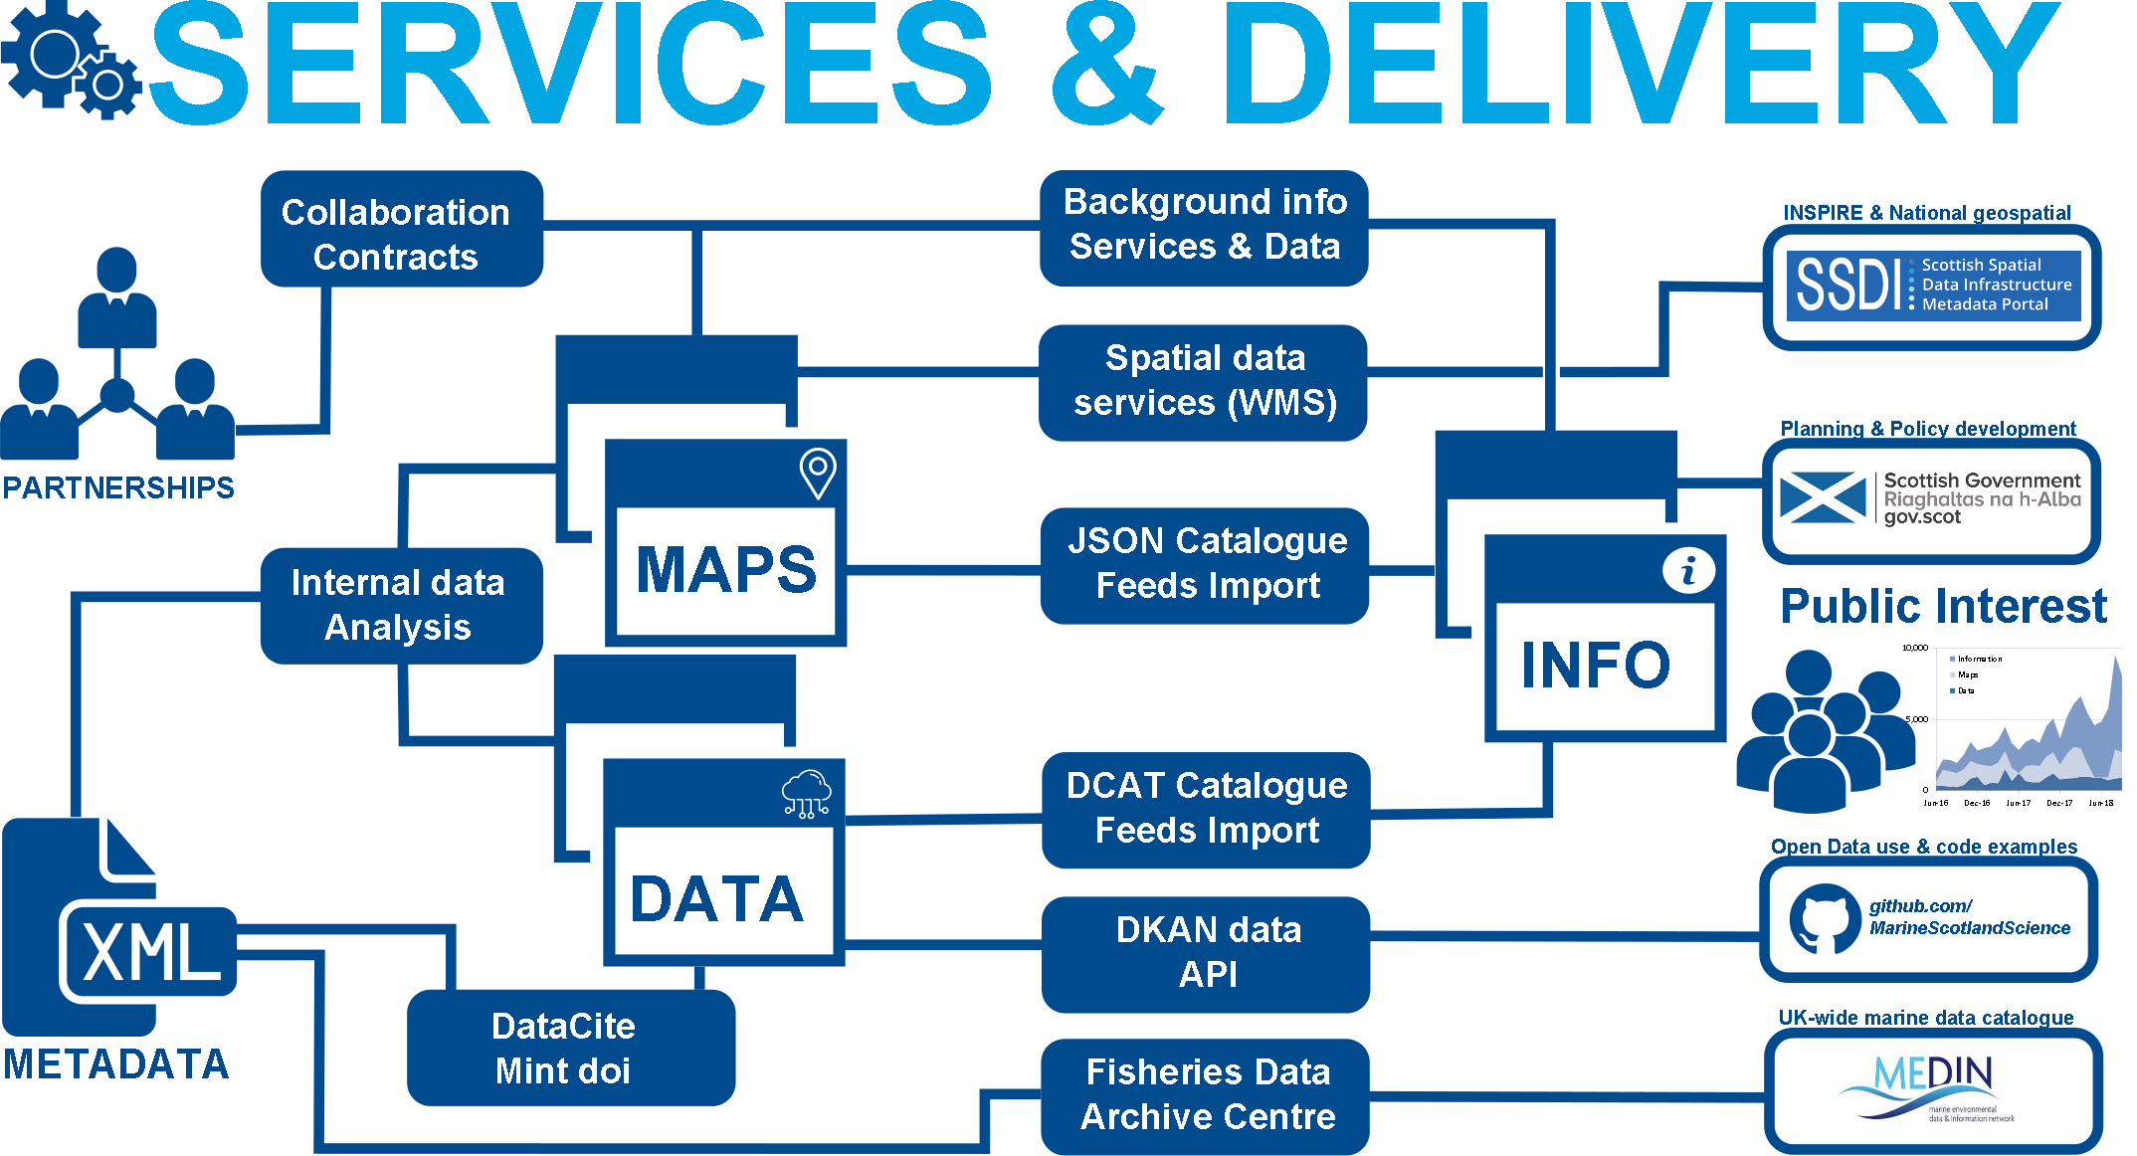
Main DAC status
19 New datasets
Scanning programme for log books and plankton records
Major database revisions underway due to win2008 + sql2008 end of life
Vocabulary updates
Representation & contact
ICES (SCICOIM, DIG, WKSEATEC)
IMDIS
OSPAR ICG-Data
EMB Big Data Group (via MASTS)

