Slide 1
Marine Data Value Chain Survey
  Will be left open until end-August
  So far, we have 169 completed responses
  Responses from people working in 17 countries, the majority of which (144) are in United Kingdom
  2020-07-10
  james.jolliffe@oecd.org

Slide 2
dac_clean | n | percent
Marine Environmental Data & Information Network (MEDIN) | 53 | 31
Other | 46 | 27
British Oceanographic Data Centre (BODC) | 30 | 18
Centre for Environment, Fisheries and Aquaculture Science (CEFAS) | 10 | 6
British Geological Survey (BGS) | 8 | 5
DASSH - The Archive for Marine Species and Habitats Data | 5 | 3
Met Office | 5 | 3
UK Hydrographic Office (UKHO) | 5 | 3
Archaeological Data Service (ADS) | 3 | 2
Historic England | 2 | 1
Crown Estate Scotland | 1 | 1
Historic Environment Scotland (HES) | 1 | 1

Slide 3
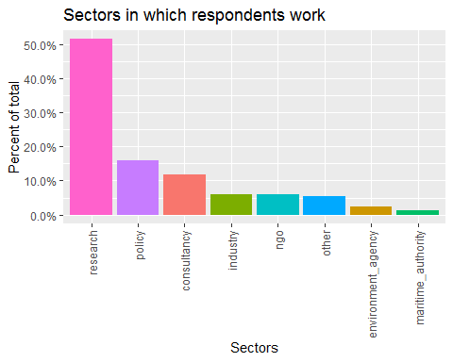

Slide 4
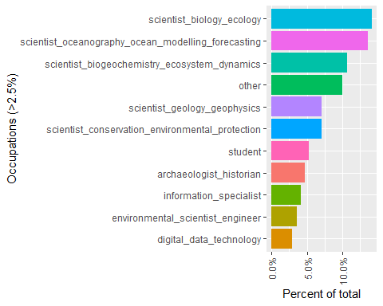

Slide 5
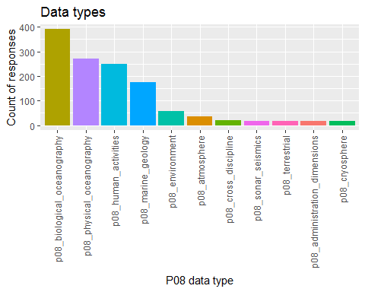

Slide 6
